Slide 1
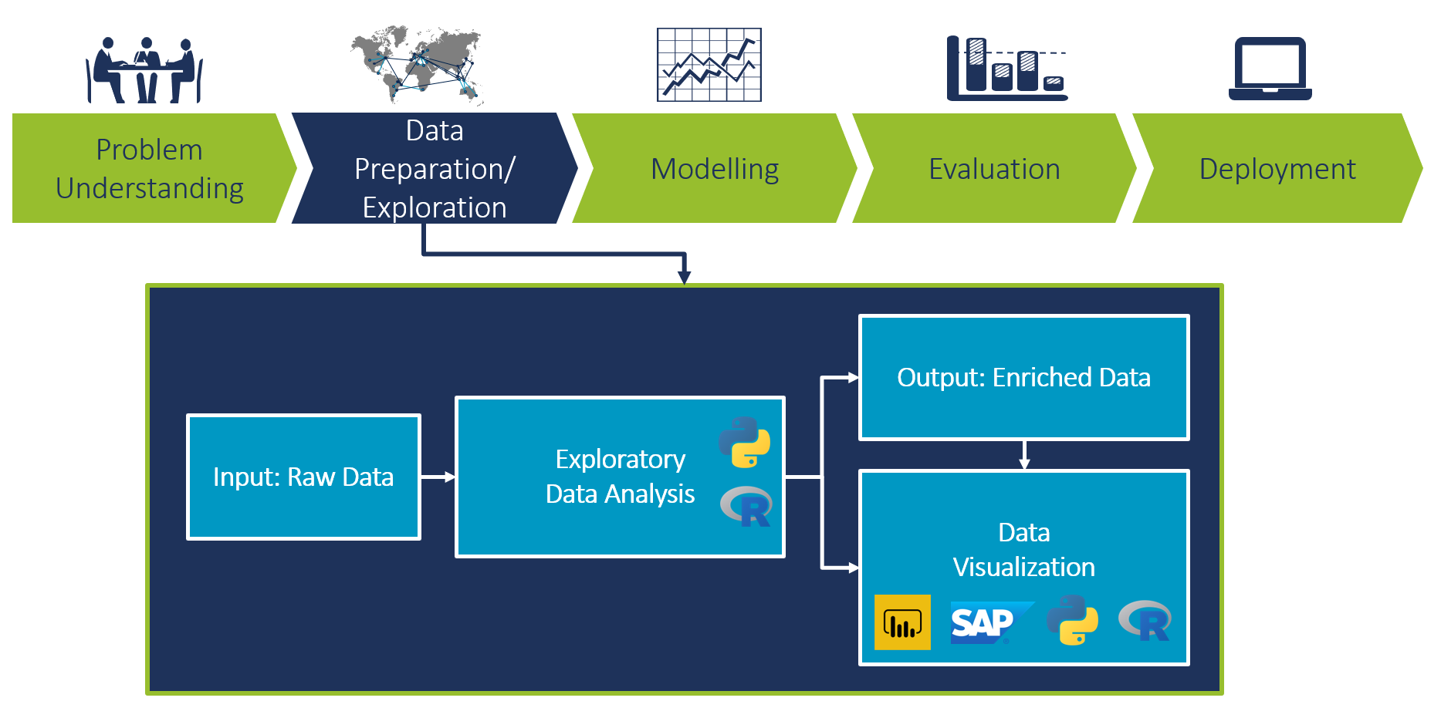
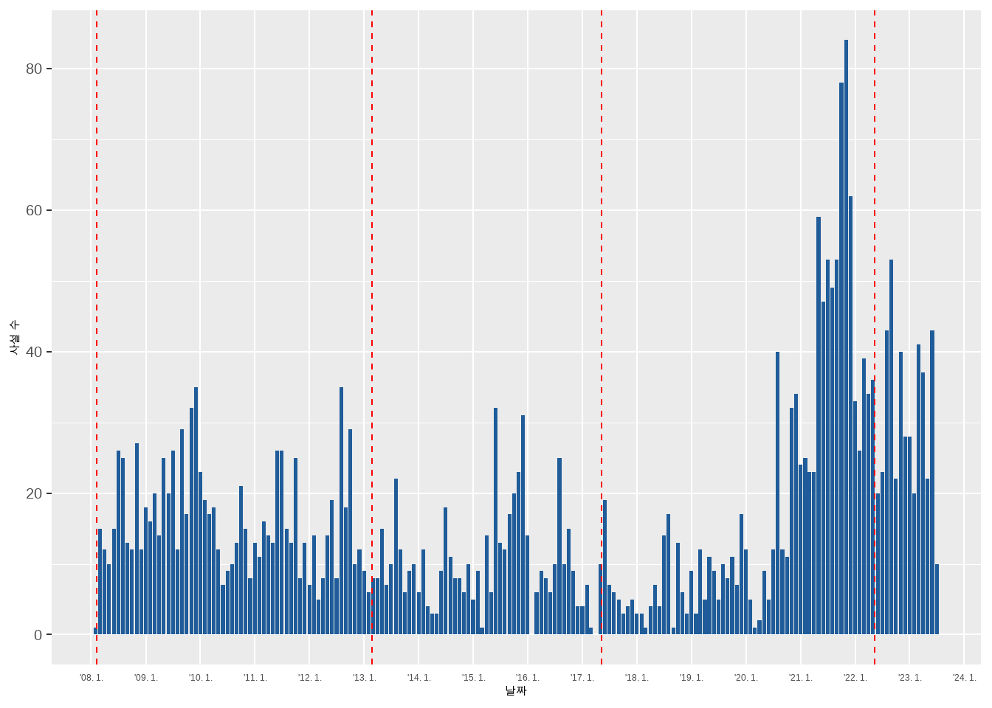
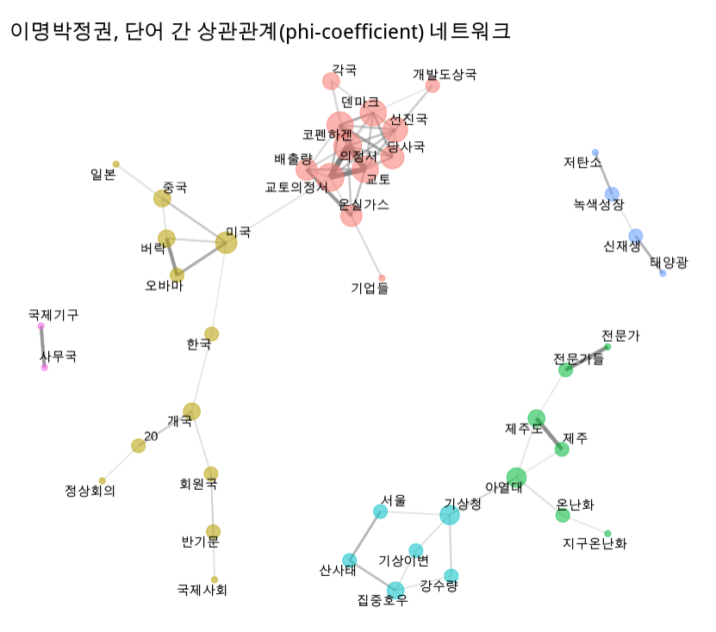

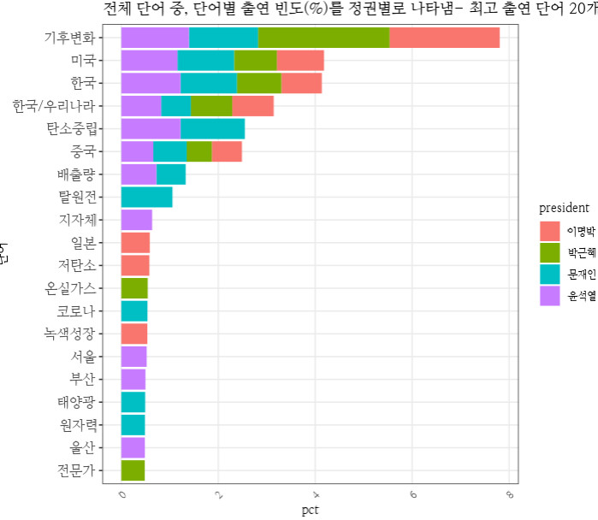
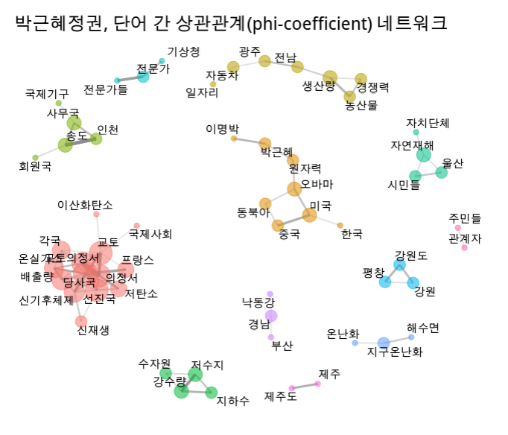
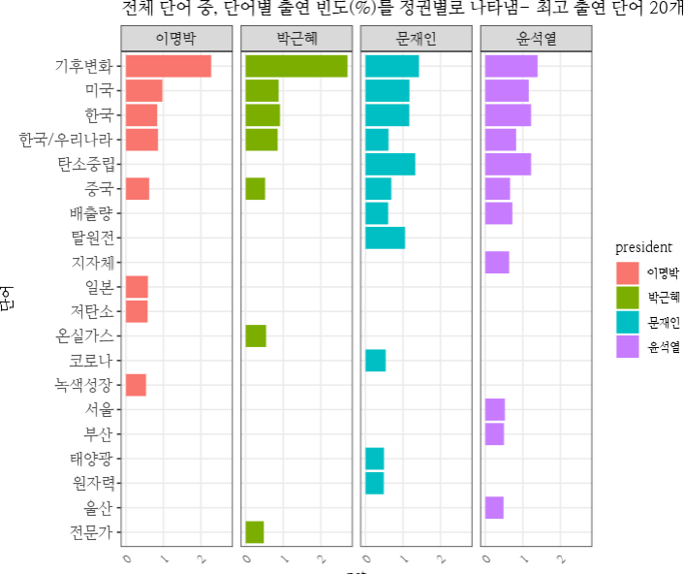
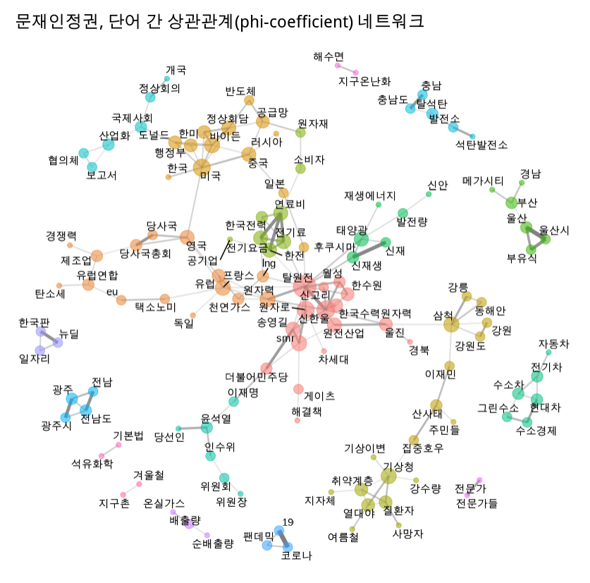
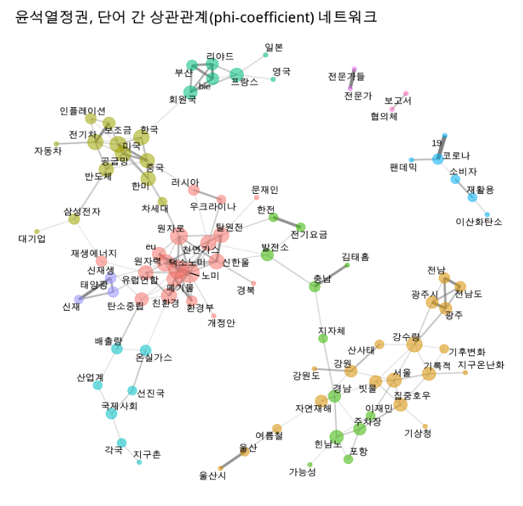
Analysis of energy policy issues based on text mining
ㅇㅇㅇㅇ
Abstract
- 전체 기간의 사설 수
Figure 1. EDA in the process of Data science
(source: Camelot ITLab)
As we have seen the trading patters of the top three most-traded fuels, they have different patterns for generating electricity. Bituminous and Nuclear power plants are known as base load power plants, and they seem to generate electricity at a constant power(or less fluctuating patterns). On the other hand, LNG power plants are for managing peak load. We can see from Figure 4 that electricity generation patterns of LNG does fluctuate much compared to the other base load power plants.
Figure 2. Explanation of data set and screenshot of raw data
- 전체 키워드 상위
Figure 4. Hourly electricity generation by fuel
Figure 5. Distribution of hourly total and each electricity generation
Our interest is to observe the behavior of each fuel in the market. In Figure 6, x-axis represents total energy trading volume at a given time and y-axis shows electricity generation of each fuel. As the total trading volume increases it seems clear that bituminous and LNG generate more electricity in order to meet the increased demand. However, generation from nuclear does not fluctuate depending on total volume.
Figure 6. Electricity generation depending on the range of total trading volume
Figure 7. Hourly mean electricity trading volume by fuel in 2021
Conclusion
It is reported that renewable energy sources, especially PV, have been widely installed and used for electricity generation with the support of carbon neutral and renewable energy policy. But in electricity trade market, fossil fuels and nuclear still takes most parts of the trade. We hereby constrain our analysis target only to bituminous, LNG, and nuclear. Other fuels except the three main fuels are merged in the name of Others.
Through exploratory data analysis (EDA) using public data, Korea's electricity transaction volume for each fuel in 2021 was analyzed. Transaction patterns to meeting fluctuating electricity demand in the electricity trading market were also identified. The three major fuels for electricity generation accounted for more than 90% of the total electricity transaction volume during the analysis period. Three fuels showed the different characteristics and how they act can be applied to the traits of base or peak load.
Acknowledgement: This work was supported by Korea Institute of Energy Research grant (C2-2443-01))
Notes:
When it comes to electricity demand, there are always minimum constant amount of electricity although demand varies from hours, seasons, weekdays or weekends. This minimum demand is known as a base load, and power plants for base load generate electricity at a constant pace compared to plants for peak load. But peak load comes at a time when electricity is need is high for a given shorter period. We will verify which fuel is on charge of meeting varying electricity demand with the given data.

